Slide 1
Scipy library
Leo Li

Slide 2
Introduction
Notes:
Scientific Computing Tools for Python
a collection of numerical algorithms and domain-specific toolboxes, including signal processing, optimization, statistics and much more.
Integration, optimization, interpolation, optimization, etc.

Slide 3
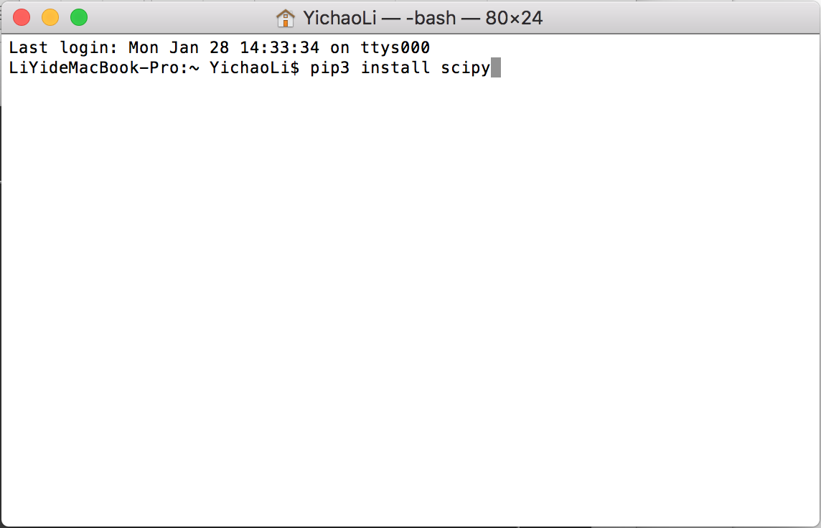
Installation

Slide 4
Integration

Slide 5
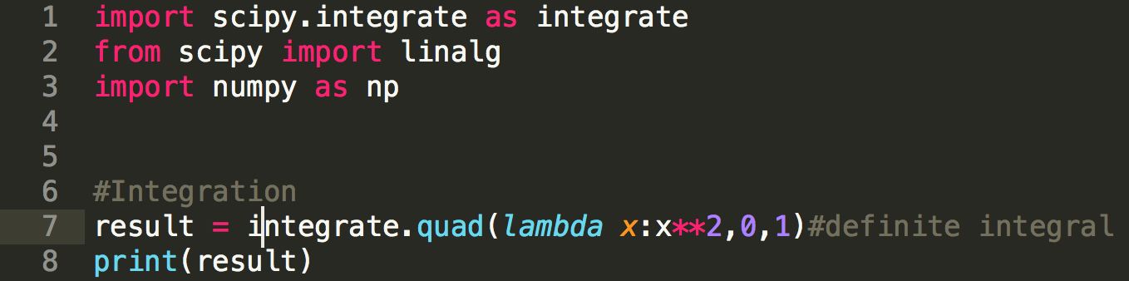
General integration

Slide 6
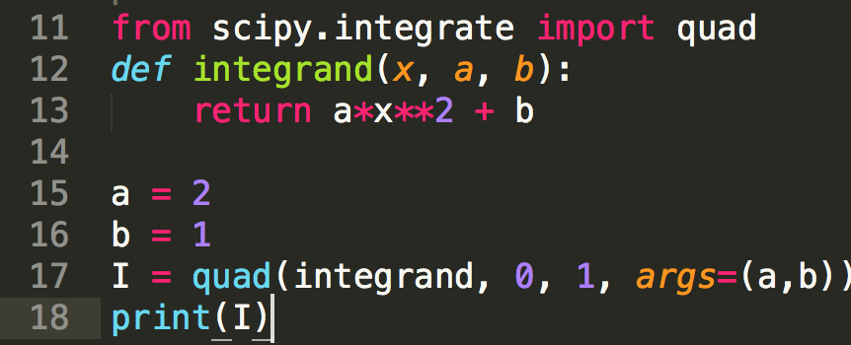
Integrating a function with parameters

Slide 7
Double integration

Slide 8
Matrix operations

Slide 9
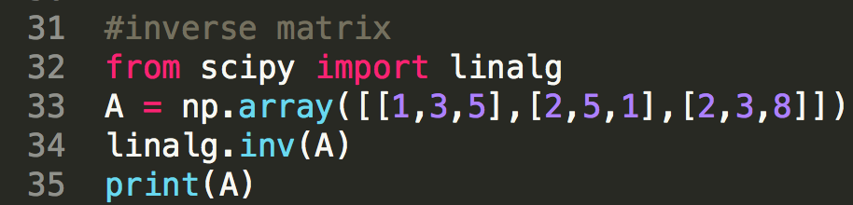
Finding inverse matrix

Slide 10
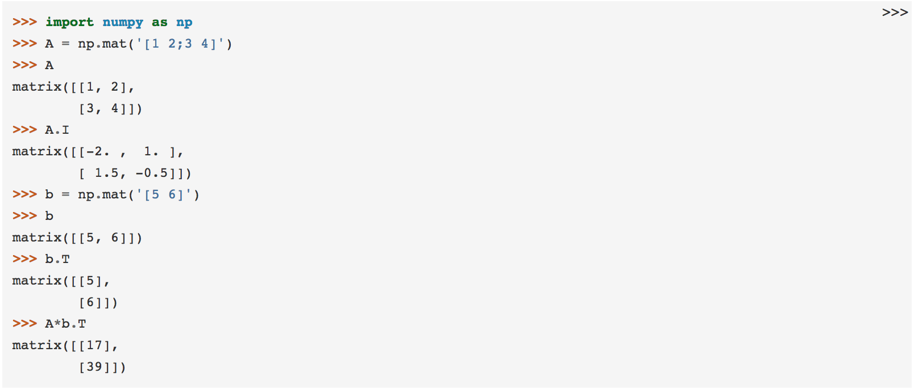
Why not Numpy???

Slide 11
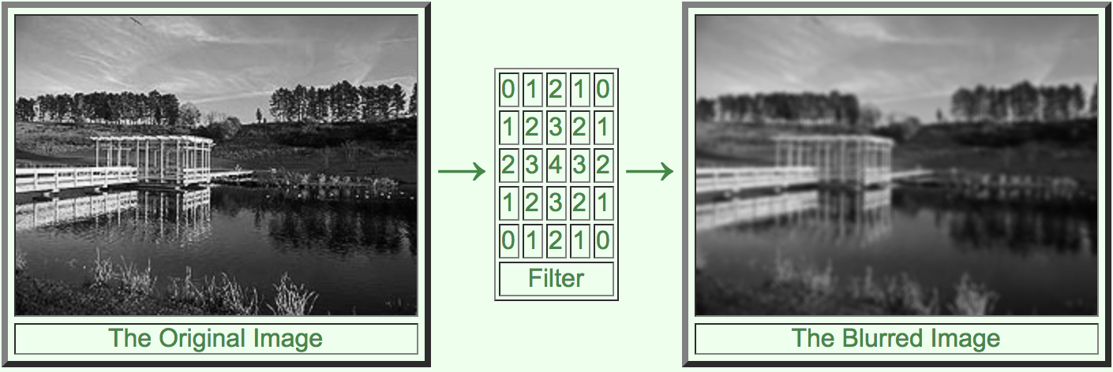
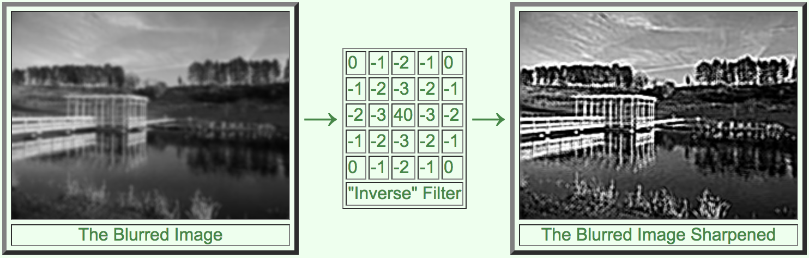
Filters

Slide 12
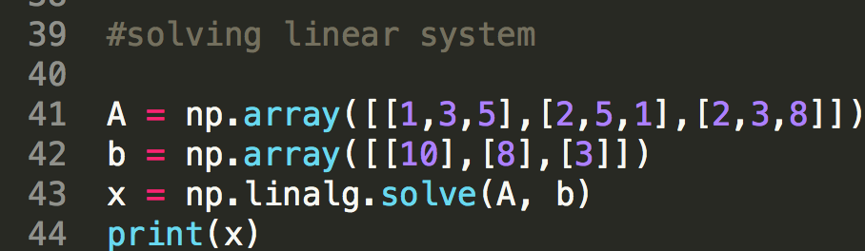
Solving linear system

Slide 13
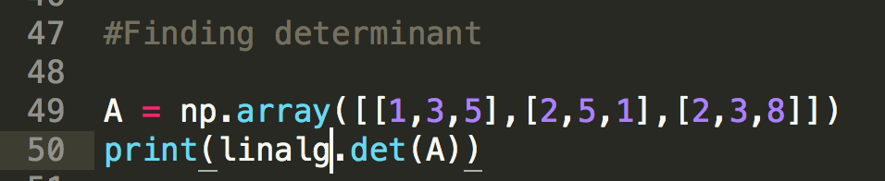
Finding determinant

Slide 14
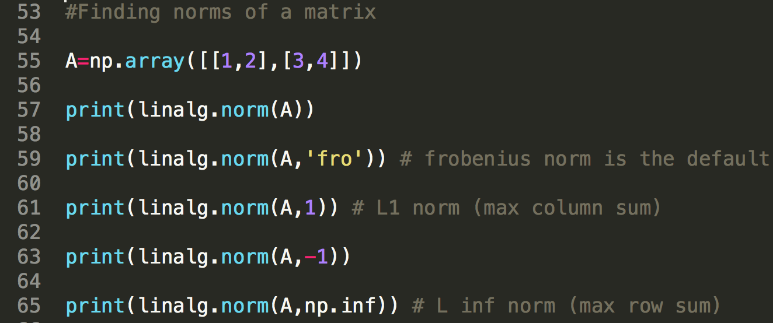
Finding norms of a matrix

Slide 15
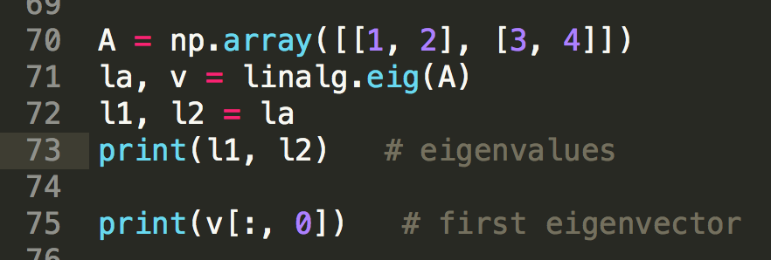
Finding eigenvalues and eigenvectors

Slide 16
Sources
https://docs.scipy.org/doc/scipy/reference/
https://www.cs.cornell.edu/boom/2003sp/ProjectArch/ConjugateGrad/index.htm

